Slide 1
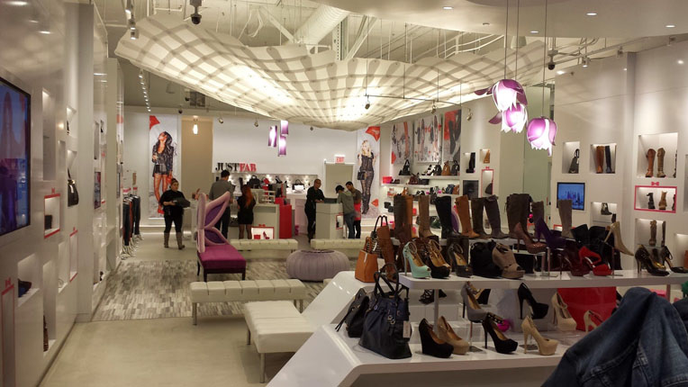
Unit 3

Slide 2

UNDERSTANDING OF RETAIL SHOPPER BEHAVIOR

Slide 3
Consumer Behavior
  Consumer behavior - the actions a person takes
  in purchasing and using products and services,
  including the mental and social processes
  that come before and after these actions.

Slide 4
Needs vs. Wants
(Typical Textbook Def.)
Needs
  Unsatisfactory conditions of the consumer that lead him or her to actions that will make the conditions better
Wants
  Desires to obtain more satisfaction than is absolutely necessary to improve unsatisfactory conditions

Slide 5
Purchase Decision Process
Need Recognition
Perceiving a value
Cultural, Social,
Individual and
Psychological
Factors
affect
all steps
Information Search
Seeking a value
Evaluation of Alternatives
Assessing value
Purchase
Buying value
Post-purchase Behavior
Assess value in consumption

Slide 6

Stimulus
Stimulus
Any unit of input affecting
one or more of the five senses:
sight
smell
taste
touch
hearing

Slide 7
Information Search: Seeking Value
Internal Search-
  Recall information from memory
External Search
information from outside environment
    Non-marketing controlled
    Marketing controlled

Slide 8
INFORMATION SEARCHIS INFLUENCED BY:
EVOKED SET:
  Group of brands that come to mind around time of purchase
CONSIDERATION SET:
  Group of brands a consumer will consider buying after search is complete

Slide 9
Alternative Evaluation
Consideration Set
Analyze product attributes
Use cutoff criteria
Rank attributes by
importance
Purchase!

Slide 10
Purchase
To buy
or not to buy...
Marketing
Determines which attributes
are most important
in influencing a
consumer’s choice
Notes:
Notes:
Following the evaluation of alternatives, the consumer decides which product to buy or decides not to buy at all.

Slide 11

Cognitive Dissonance
Cognitive
Dissonance
Inner tension that a consumer experiences after recognizing an inconsistency between behavior and values or opinions.
Notes:
Notes:
Once a purchase decision is made, the next step in the process is the evaluation of the product after purchase. Consumers expect certain outcomes from the purchase, and how well these expectations are met determines the level of customer satisfaction.
Price influences the level of expectations for a product or service.
When people feel inconsistency between their values or opinions and their behavior, they feel an inner tension called cognitive dissonance. In purchase decisions, this is also called “buyer’s remorse.” 75 percent of consumers say they had a bad experience in the last year with a product purchased. Marketers try to reduce any lingering doubt.

Slide 12
Post-purchase Behavior-
Cognitive Dissonance
Inner tension that a consumer experiences after recognizing an inconsistency between behavior and values or opinions.
Cognitive Dissonance
?
Marketing
Did I make a good decision?
Did I buy the right product?
Did I get a good value?
Can minimize through:
Effective Communication
Follow-up
Guarantees
Warranties

Slide 13
Factors Influencing
Buying Decisions
Cultural
Factors
Social
Factors
CONSUMER
DECISION-
MAKING
PROCESS
BUY /
DON’T BUY
Individual
Factors
Psycho-logical
Factors
Notes:
Notes:
The consumer decision-making process is strongly influenced by cultural, social, individual, and psychological factors.
Exhibit 5.3 summarizes these influences.

Slide 14
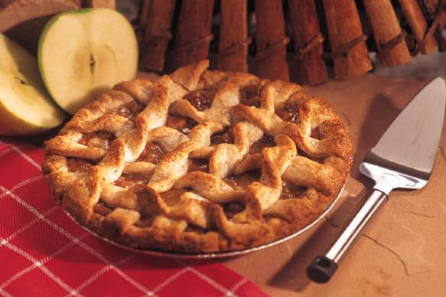
Culture
Culture
Set of values, norms, attitudes, and other meaningful symbols that shape human behavior and the artifacts, or products, of that behavior as they are transmitted from one generation to the next.
Notes:
Notes:
Cultural factors exert the deepest influence over consumer behavior and decision making.
Culture is the character of society, and the underlying elements of every culture are values, language, myths, customs, rituals, and laws, as well as material artifacts.

Slide 15


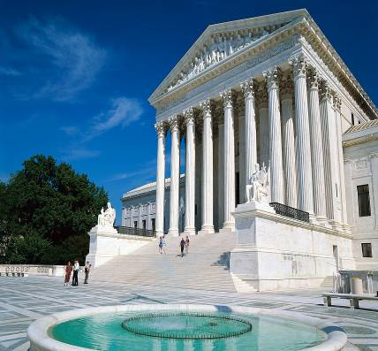
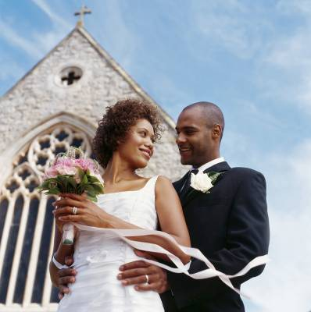
Components of Culture
Values
Language
Tradition
Customs
Rituals (religious ceremonies)
Laws
Material artifacts
Notes:
Notes:
1. This list contains the defining components of culture. Push students to think about American cultural elements for each category. Slide 40 in this deck will give a sample list of values.

Slide 16

Value
Value
Enduring belief that a specific mode of conduct is personally or socially preferable to another mode of conduct.
Notes:
Notes:
The most defining element of a culture is its values.
People with similar value systems tend to react alike to prices and other marketing-related inducements.
Values also correspond to consumption patterns.

Slide 17

Core American Values
Success
Materialism
Freedom
Progress
Youth
Capitalism
Notes:
Online
The Source
What culture does the material at The Source Web appeal to? How would you define it? Consider that culture in terms of its components, and explain why you think The Source transcends the typical racial segmentation of culture.
Notes:
This slide lists components of core American values—those considered central to the American way of life.
The personal values of the target market have important implications for marketing managers. When marketers understand the core values, they can target their message more effectively. For example, the personal values of seniors, baby boomers, and Generations X and Y are quite different.
Discussion/Team Activity:
Discuss the personal values of each of the age groups listed above, and what marketing managers can do to appeal to each group.

Slide 18
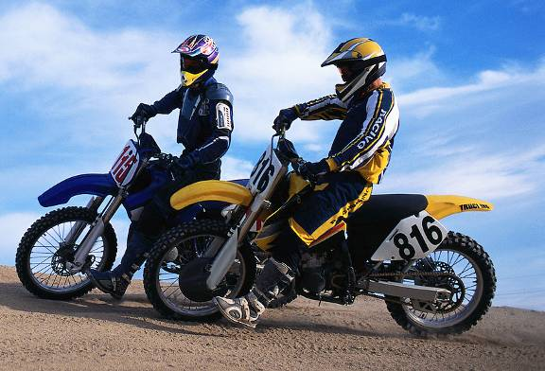
Subculture
Subculture
A homogeneous group
of people who share elements of the overall culture as well as unique elements of their own group.
Notes:
Online
Grateful Dead
What kind of marketing program could you design to attract the subculture of Grateful Dead followers? Visit the GD Online Store to see how marketers are currently doing this. What other elements of the site could help you design a successful program?

Slide 19

Social Class
Social Class
A group of people in a society who are considered nearly equal in status or community esteem, who regularly socialize among themselves both formally and informally, and who share behavioral norms.

Slide 20
Social Influences on
Consumer Buying Decisions
Identify and understand the
social factors that affect consumer buying decisions

Slide 21
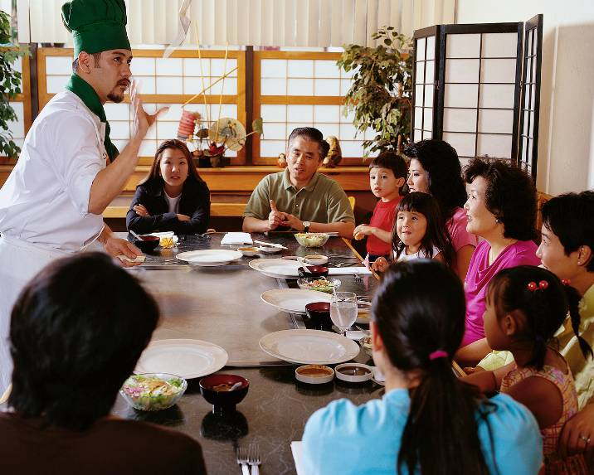
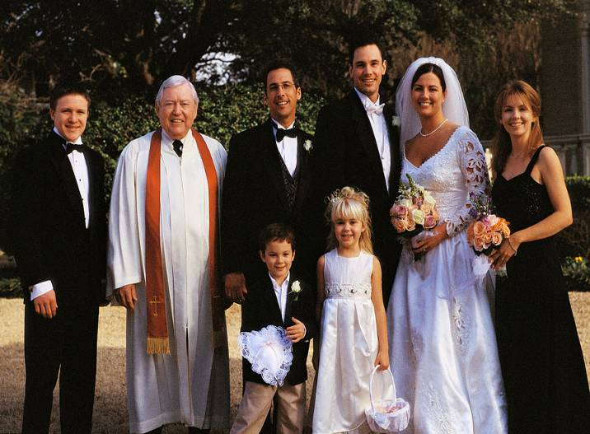
Social Influences
Reference Groups
Opinion Leaders
Family Members
Notes:
Notes:
Consumers interact socially with reference groups, opinion leaders, and family members to obtain product information and decision approval.

Slide 22
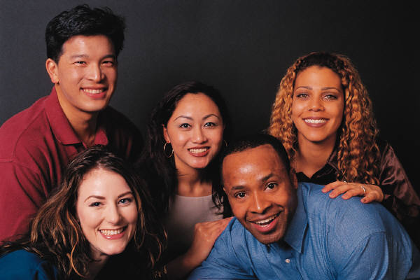
Reference Group
Reference Group
A group in society that influences an individual’s purchasing behavior.

Slide 23

Opinion Leaders
Opinion Leaders
An individual who influences
the opinion of others.
Notes:
Notes:
Reference groups often include individuals known as opinion leaders who influence others.

Slide 24
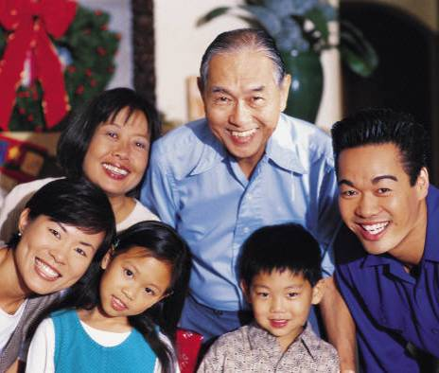
Family
Purchase Process Roles in the Family
Initiators
Influencers
Decision Makers
Purchasers
Consumers
Notes:
Notes:
The family is the most important social institution for many consumers, influencing values, attitudes, and buying behavior.
Purchase decisions vary significantly among family members, who assume a variety of roles in the purchase process.
Initiators are the ones who suggest or initiate the purchase process.
Influencers are those members whose opinions are valued.
Decision makers actually makes the decision to buy or not to buy.
The purchaser is the one who exchanges money for the product.
The consumer is the one who uses the product.
Children can have great influence over the purchase decision.

Slide 25
Individual Influences on
Consumer Buying Decisions
Identify and understand the individual factors that affect consumer buying decisions

Slide 26
Individual Influences
Gender
Age
Life Cycle
Personality
Self-Concept Lifestyle
Notes:
Notes:
A person’s buying decisions are also influenced by unique personal characteristics, such as gender; age and family life cycle; and personality, self-concept, and lifestyle.
The physiological differences in men and women result in the need for different products. In addition, the distinct cultural, social, and economic roles of men and women result in differing decision-making processes. Men and women shop differently. As a broad statement, women enjoy shopping; men shop out of necessity in more convenient stores with less variety. Trends in gender marketing are influenced by the changing roles of men and women. With working women on the rise, many industries are directing their marketing attention to women.
The age and family life cycle can have a significant impact on consumer behavior. Consumer tastes in clothes, food, cars, and recreation are often age related. Related to age is the family life cycle, an orderly series of stages through which consumers’ attitudes and behavior evolve through maturity, experience, and changing income and status.
Personality is a broad concept combining psychological makeup and environmental forces. Self-concept combines the ideal self-image and the real self-image. Consumers seldom buy products that jeopardize their self-image. A lifestyle is a mode of living as identified by a person’s activities, interests, and opinions.

Slide 27
Psychological Influences on
Consumer Buying Decisions
Identify and understand the psychological factors that affect consumer buying decisions

Slide 28
Psychological Influences
Perception
Motivation
Learning
Beliefs & Attitudes
Notes:
Notes:
The psychological influences are the factors consumers use to interact with their world. They are the tools used to recognize feelings, gather and analyze information, formulate thoughts and opinions, and take action.

Slide 29
Perception
Perception
Process by which people select, organize, and interpret stimuli into a meaningful and coherent picture.

Slide 30
Perception
Selective
Exposure
Selective
Distortion
Selective
Retention
Notes:
Notes:
People cannot perceive every stimulus in their environment. They use selective exposure, along with the closely related concepts of selective distortion and retention to decide which stimuli to notice and which to ignore.

Slide 31
Perception
Selective
Exposure
Consumer notices certain stimuli
and ignores others
Selective
Distortion
Consumer changes or distorts information that conflicts
with feelings or beliefs
Selective
Retention
Consumer remembers only
that information that
supports personal beliefs
Notes:
Discussion/Team Activity:
Discuss examples representing each of the described perception states.

Slide 32
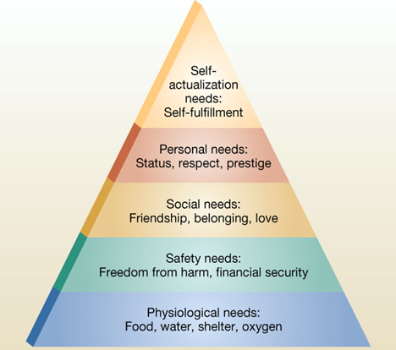
PSYCHOLOGICAL INFLUENCES
ON CONSUMER BEHAVIOR
Motivation – what stimulates behavior to satisfy a need
Maslow’s Hierarchy
of Needs

Slide 33
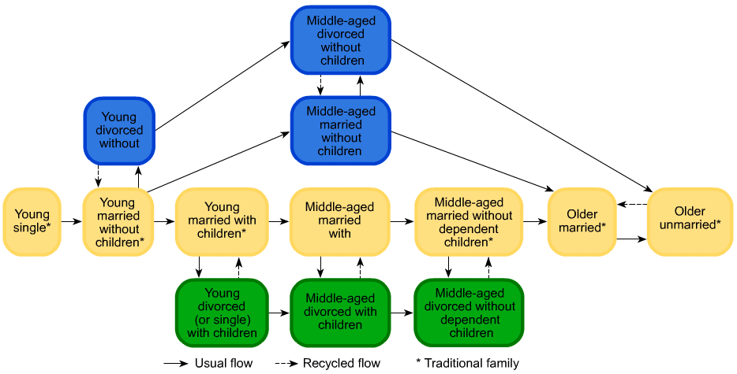
SOCIOCULTURAL INFLUENCES
ON CONSUMER BEHAVIOR
Family Life Cycle

Slide 34
SOCIOCULTURAL INFLUENCES
ON CONSUMER BEHAVIOR
Family Decision Making
Information Gatherer
Purchaser
Decision Maker
Influencer
User
Members assume different roles for different products
Men’s clothes?
Breakfast cereal?
Computer?

Slide 35

Purchase Decision Process
  The purchase decision process is the stages a buyer passes through in making choices about which products and services to buy.

Slide 36
Involvement
  Involvement consists of the personal, social, and economic significance of the purchase to the consumer.

Slide 37
Motivation
  Motivation is the energizing force that stimulates behavior to satisfy a need.

Slide 38
Learning
  Learning refers to those behaviors that result from (1) repeated experience and (2) reasoning.

Slide 39
Brand Loyalty
  Brand loyalty is a favorable attitude toward and consistent purchase of a single brand over time.

Slide 40
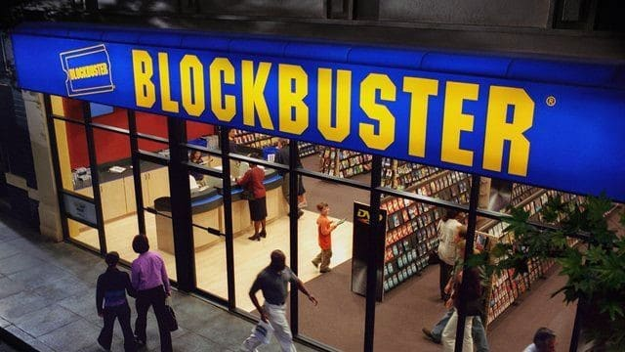

Slide 41
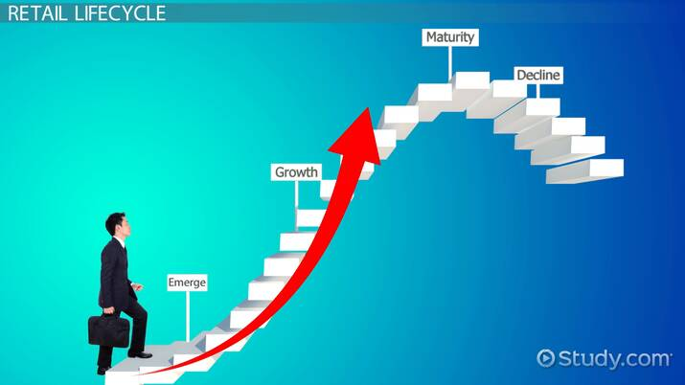


Slide 42
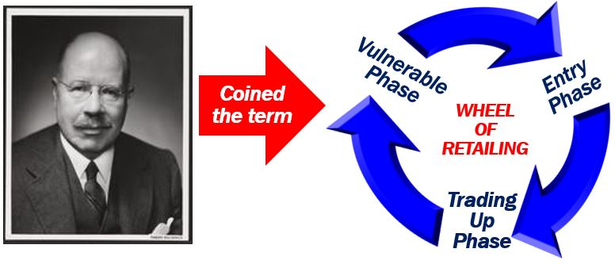
Malcolm P. McNair coined the term ‘Wheel of Retailing’.

Slide 43
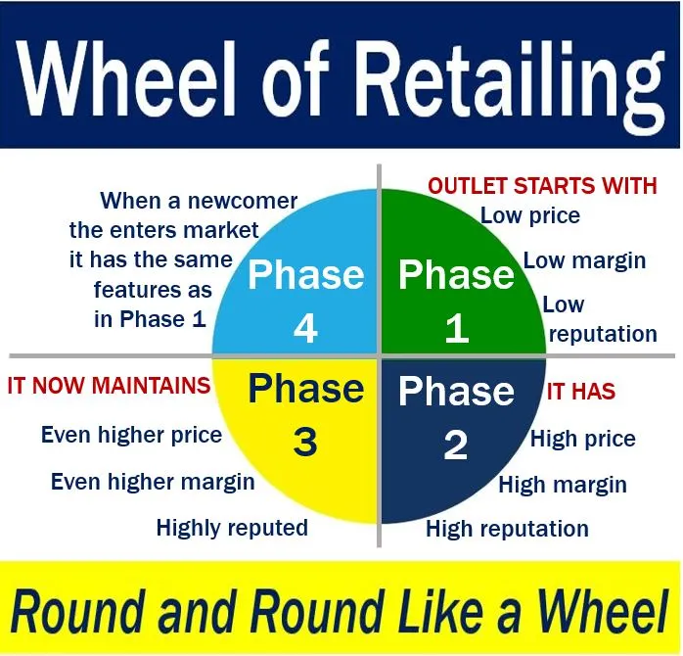

Slide 44
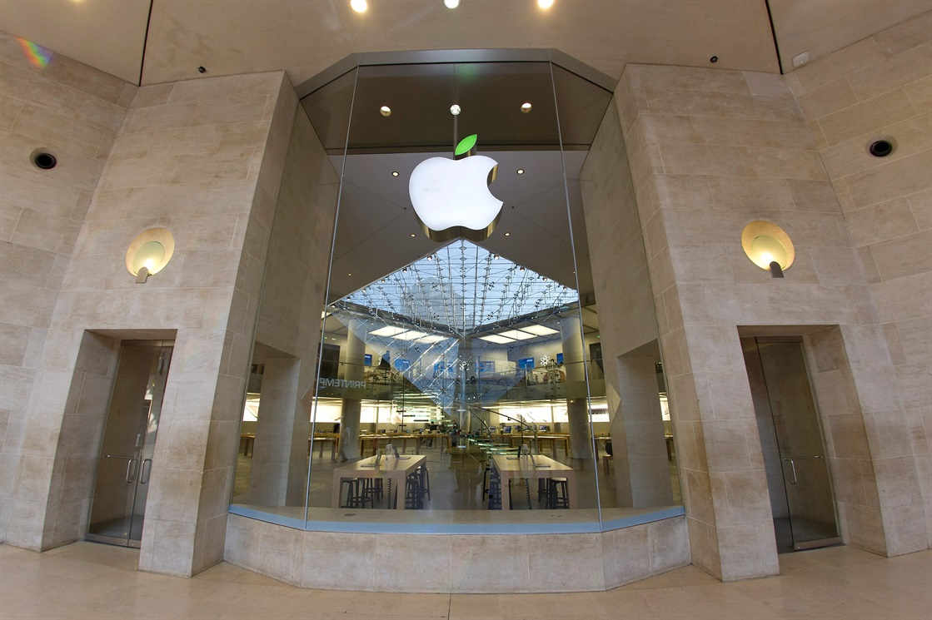
Vertical Marketing System
An organised, structured and unified distribution channel system in which producer and intermediaries or middlemen (wholesalers and retailers) work closely together to facilitate the smooth flow of goods and services from producer to end-user.

Slide 45

Horizontal Marketing System
A Horizontal Marketing system is a form of distribution channel wherein two or more companies at the same level unrelated to each other come together to gain the economies of scale.
Two or more Manufacturers- This collaboration is made with the objective of efficient utilization of all scarce resources.
Two or more Wholesalers- It is done with the motive of covering a wider area for distributing goods and services.
Two or more Retailers- Retails collaborates with one another for providing products in a particular area in bulk quantities.

Slide 46

MULTICHANNEL MARKETING
Multichannel marketing is the implementation of a single strategy across multiple channels or platforms, thus maximizing opportunities to interact with prospective customers
Multichannel marketing refers to the practice of interacting with customers using a combination of indirect and direct communication channels – websites, retail stores, mail order catalogs, direct mail, email, mobile, etc

Slide 47
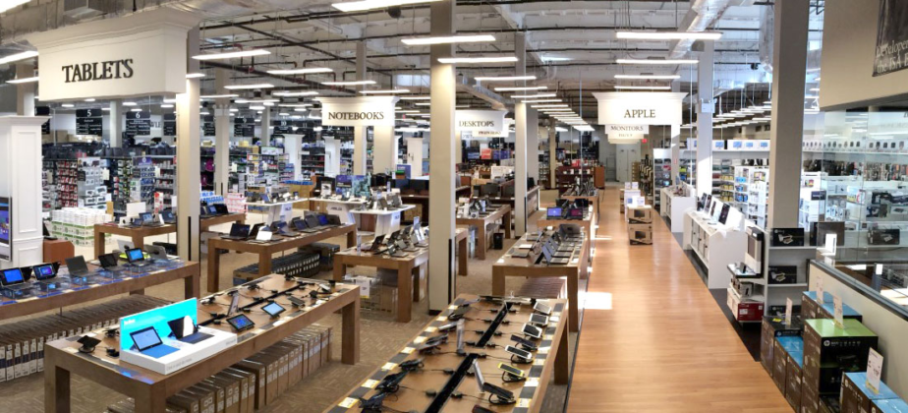
Scrambled Merchandising
Scrambled merchandising refers to a retail tactic in which a retailer broadens their assortment to include items that are generally outside their focus or are usually sold in a different retail format.

